Slide 1

Training Workshop
Session 2: Review of FEM &
ABAQUS System

Slide 2
ABAQUS Tutorial
Dynamic &
Contact FEA
Postprocessing
ABAQUS
Material &
Section Properties
Job Processing
(Solver)
Loading &
Analysis Steps
Meshing

Slide 3
ABAQUS Solvers
ABAQUS/Standard
  solves system of equations implicitly at each solution “increment”.
ABAQUS/Explicit
  marches solution forward through time in small time increments without solving coupled system of equations at each increment.

Slide 4
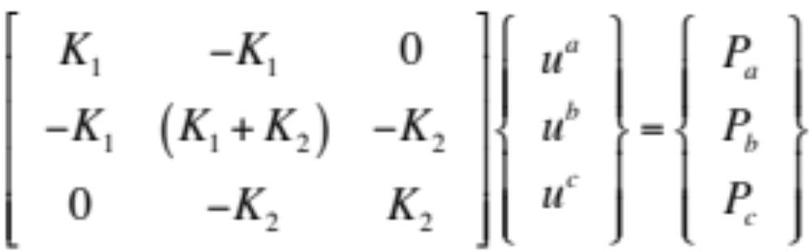
ABAQUS/Standard
Implicit
truss
free-body diagrams for each node
P_{a}
ℓ¹_{a}
ℓ¹_{b}
P_{b}
ℓ²_{b}
ℓ²_{c}
P_{c}
a
b
c
discretized model
equilibrium equation
a
➀
b
➁
c
element
node

Slide 5
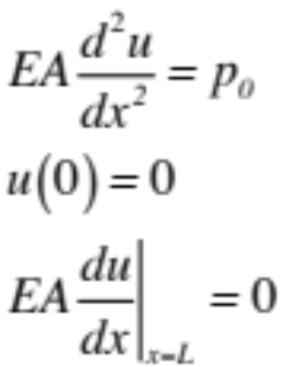
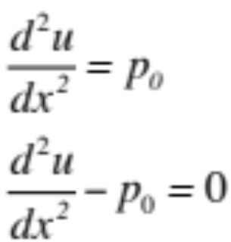
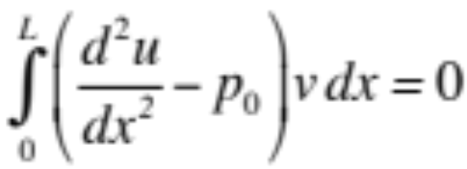
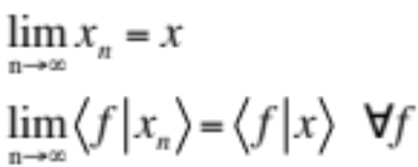
FEM Strong & Weak Formulations
The set of governing PDEs with boundary conditions is the strong form.
The weak form is a variational statement of the problem integrated against a test function.
strong
weak
A solution of the strong form will also satisfy the weak form, but not vice versa.

Slide 6
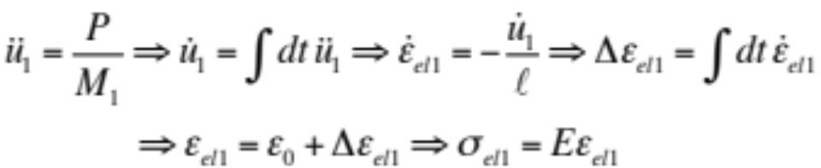
ABAQUS/Explicit
Explicit
1
2
3
P
➀
➁
➂
initial configuration
ℓ
ℓ
ℓ
1
2
3
P
➀
➁
➂
end of increment 1
≠ℓ
ℓ
ℓ

Slide 7
Comparison of Implicit and Explicit
Features
Quantity | ABAQUS/Standard | ABAQUS/Explicit
Element library | Extensive | Extensive subset suitable for explicit analysis
Analysis procedures | General & linear perturbation procedures available. | General procedures are available.
Material models | Wide range of material models. | Wide range plus failure material models.
Contact formulation | Has a robust capability for solving contact problems. | Has a robust contact functionality that readily solves even the most complex contact simulations.
Solution technique | Unconditionally stable stiffness-based solution technique | Conditionally stable explicit integration solution technique
Disk space & memory | With many iterations, can be large | Disk space and memory usage typically much smaller than ABAQUS/Standard

Slide 8
Comparison of Implicit and Explicit
Cost of Mesh Refinement
Implicit
Explicit
computational cost
degrees of freedom
Explicit—computational cost proportional
to number of elements and smallest
element dimension
Implicit—computational cost
proportional to square of
degrees of freedom

